Slide 1
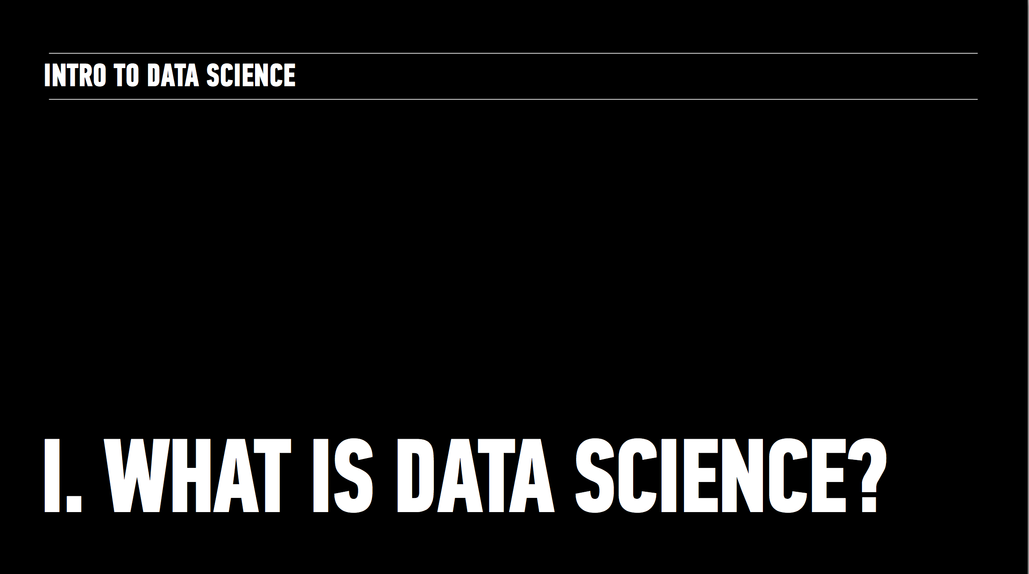
GENERAL ASSEMBLY
DATA SCIENCE

Slide 2
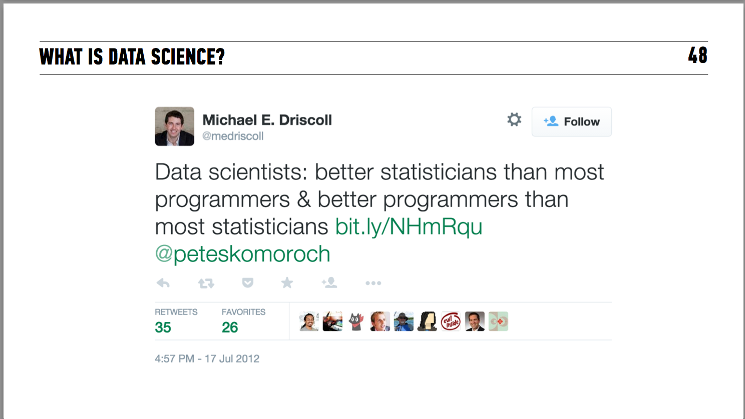

Slide 3
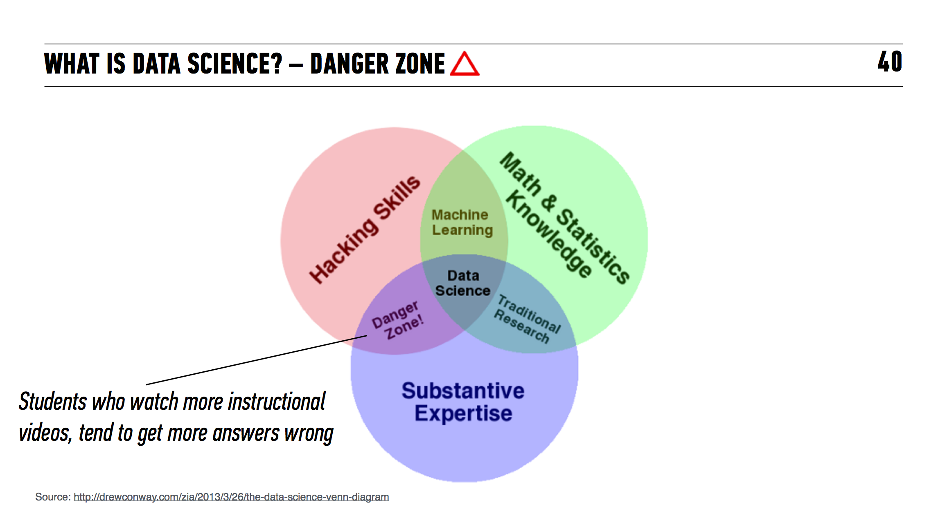
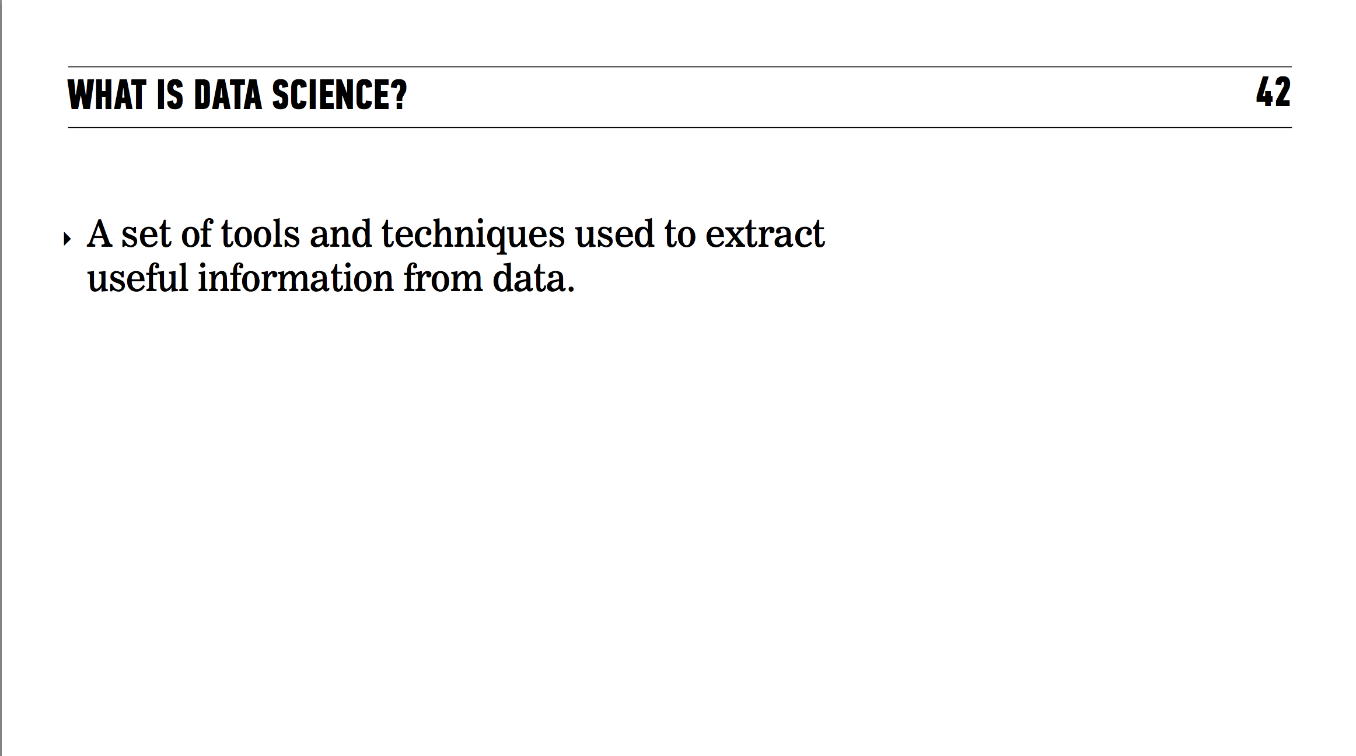

Slide 4
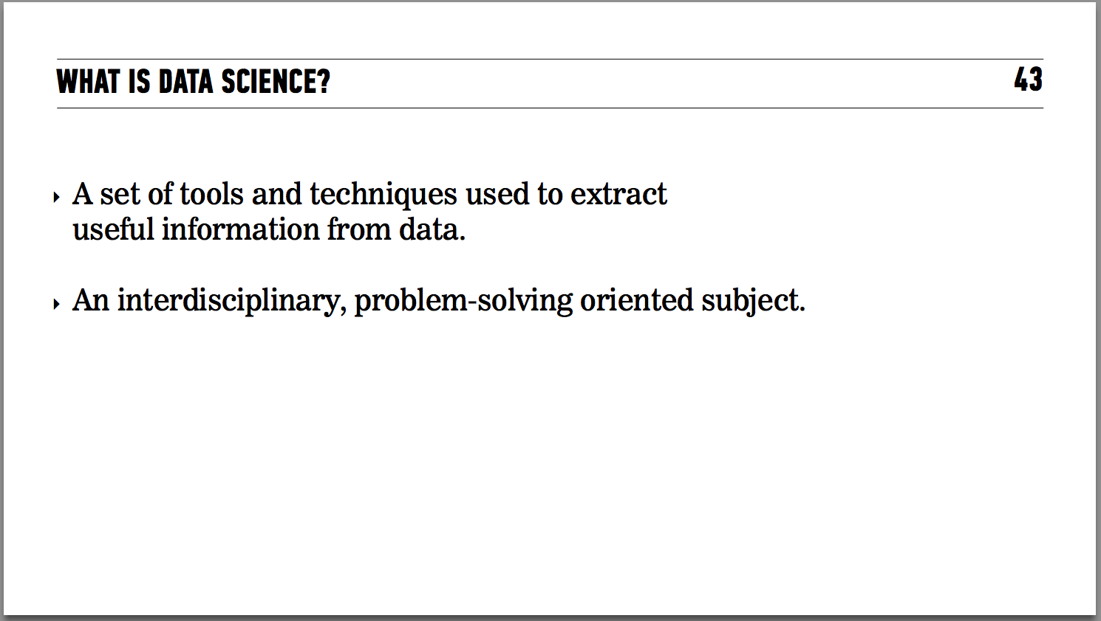

Slide 5
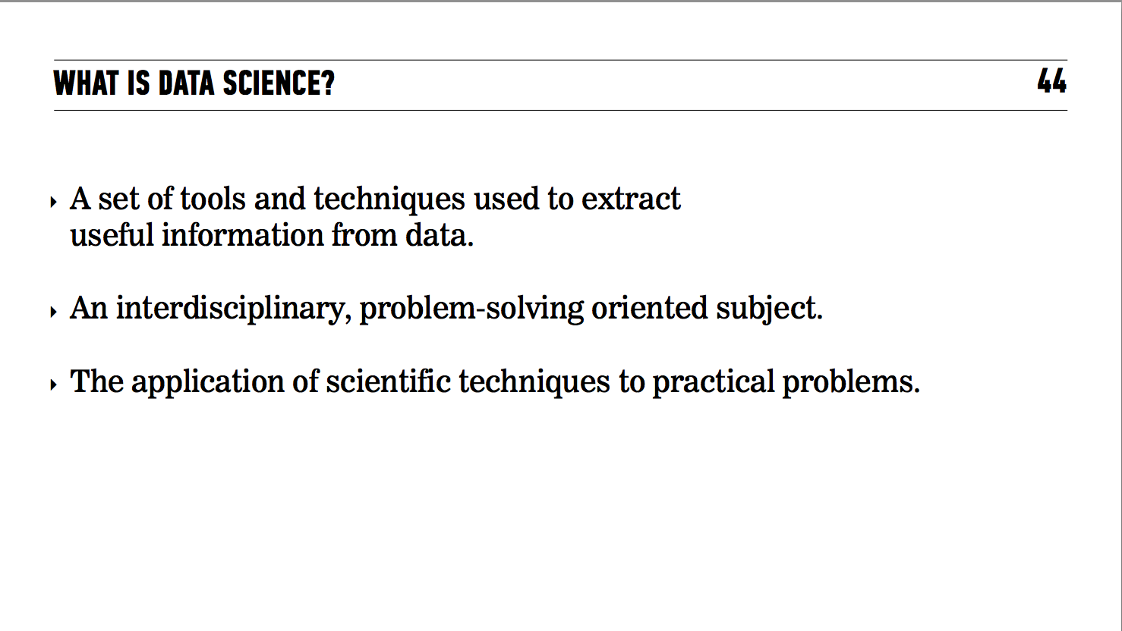

Slide 6
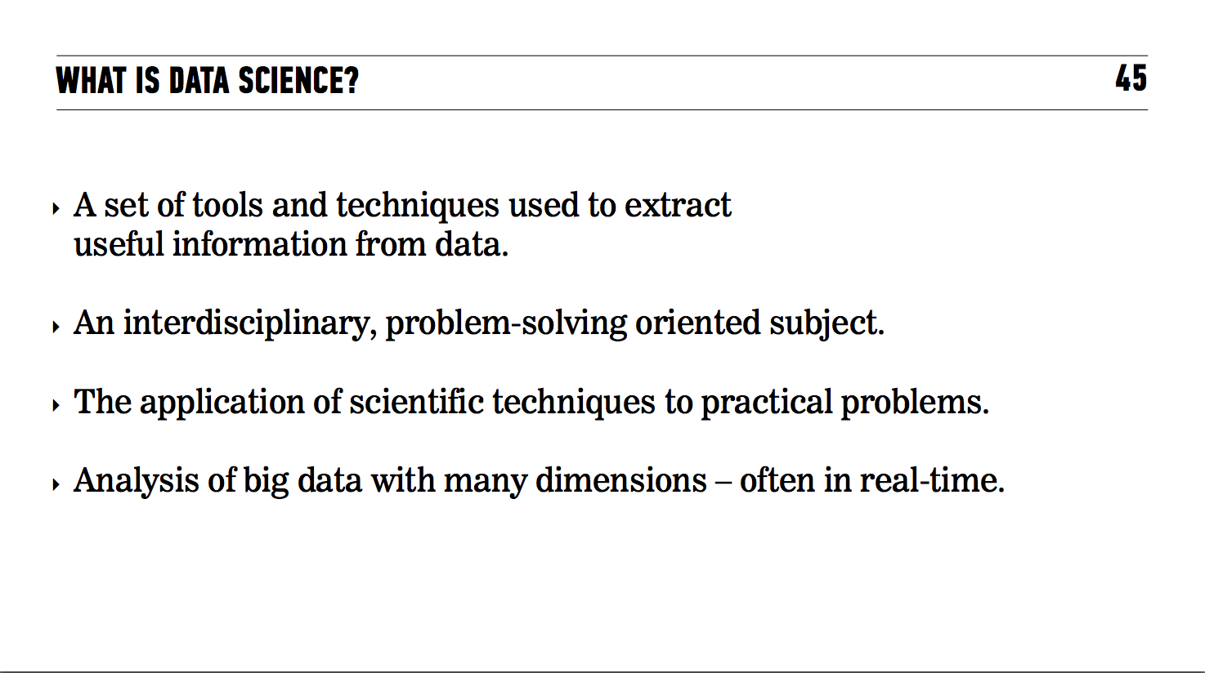

Slide 7
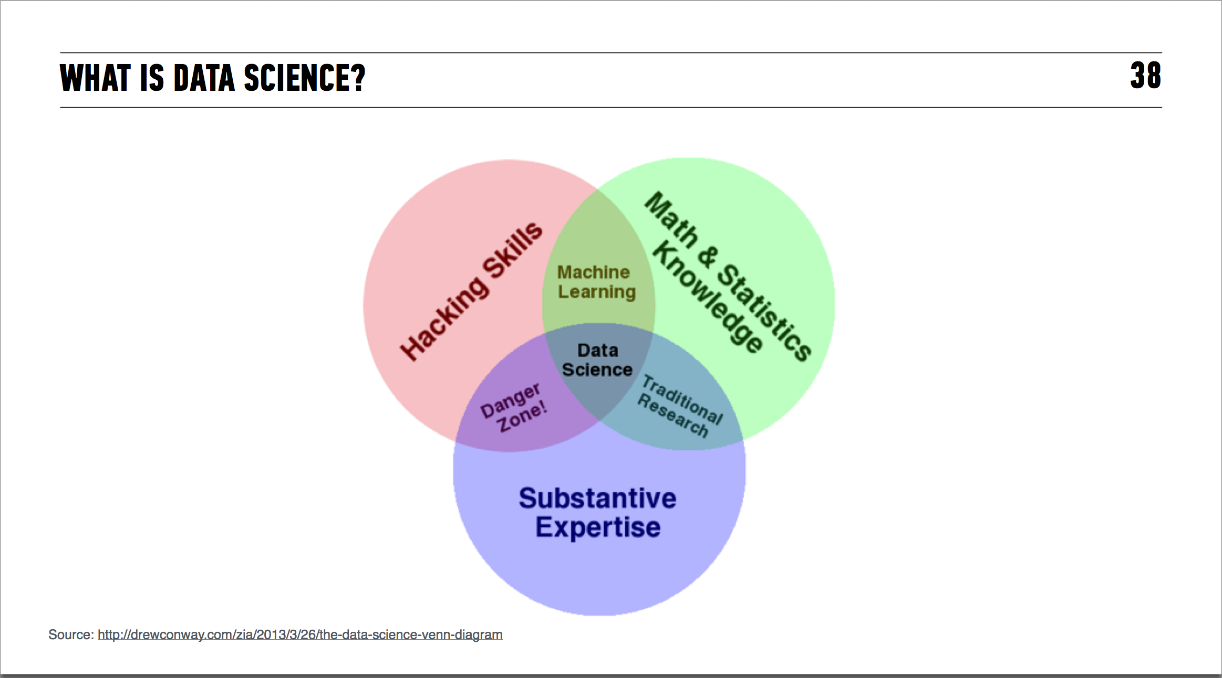

Slide 8
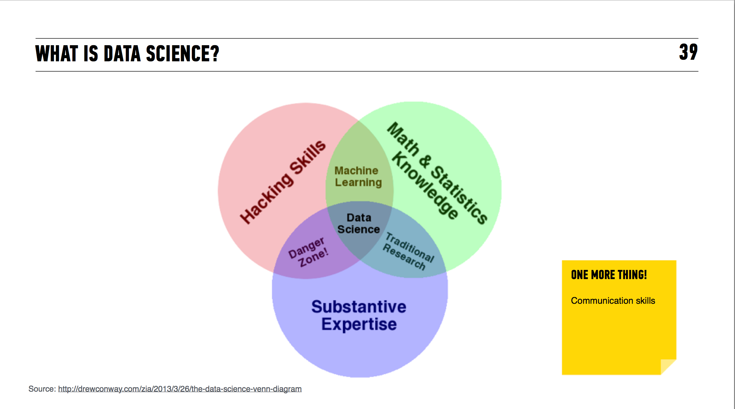

Slide 9
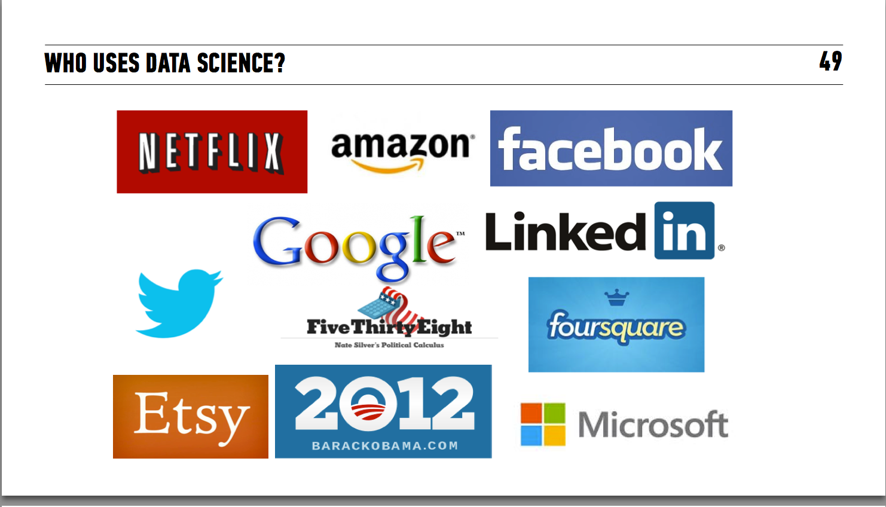

Slide 10
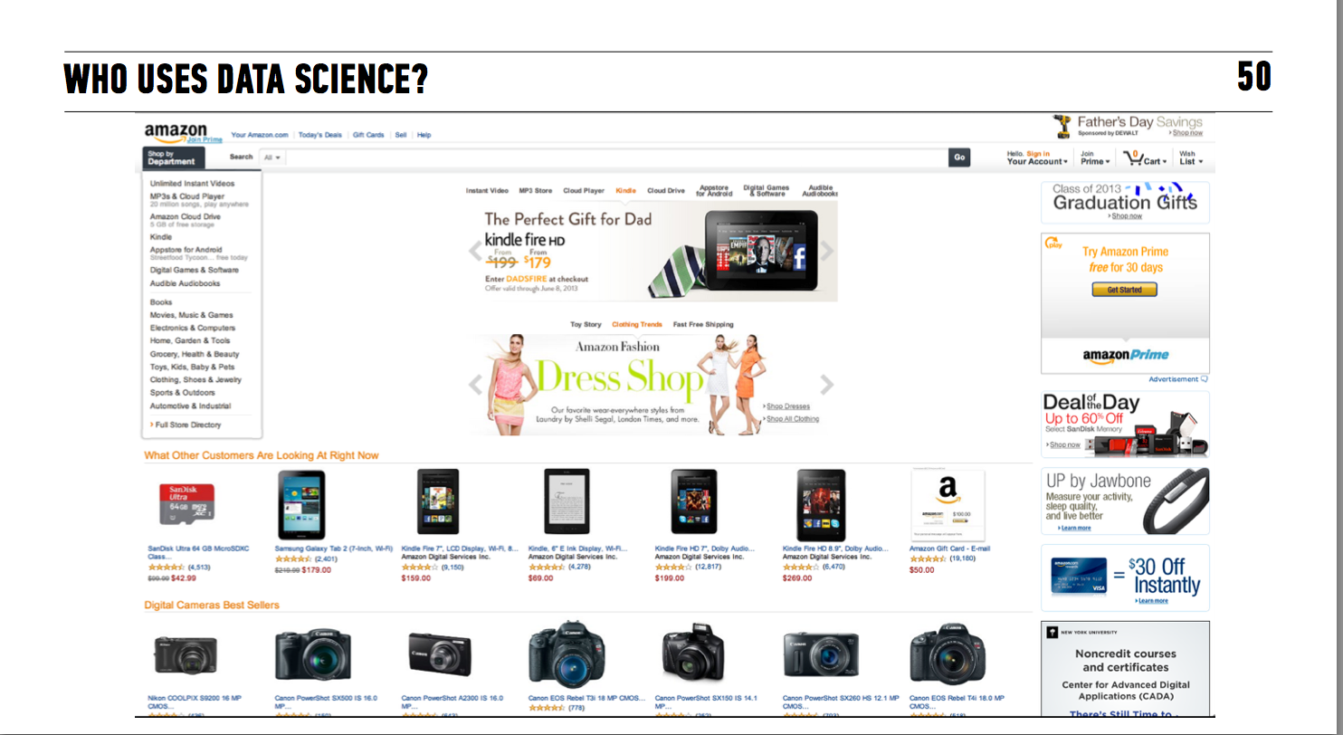

Slide 11
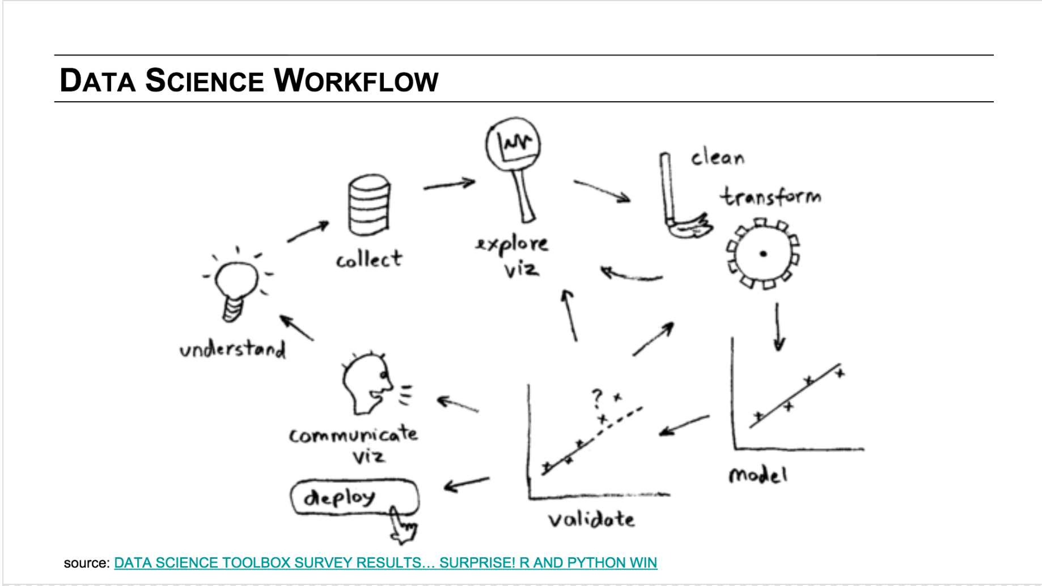

Slide 12
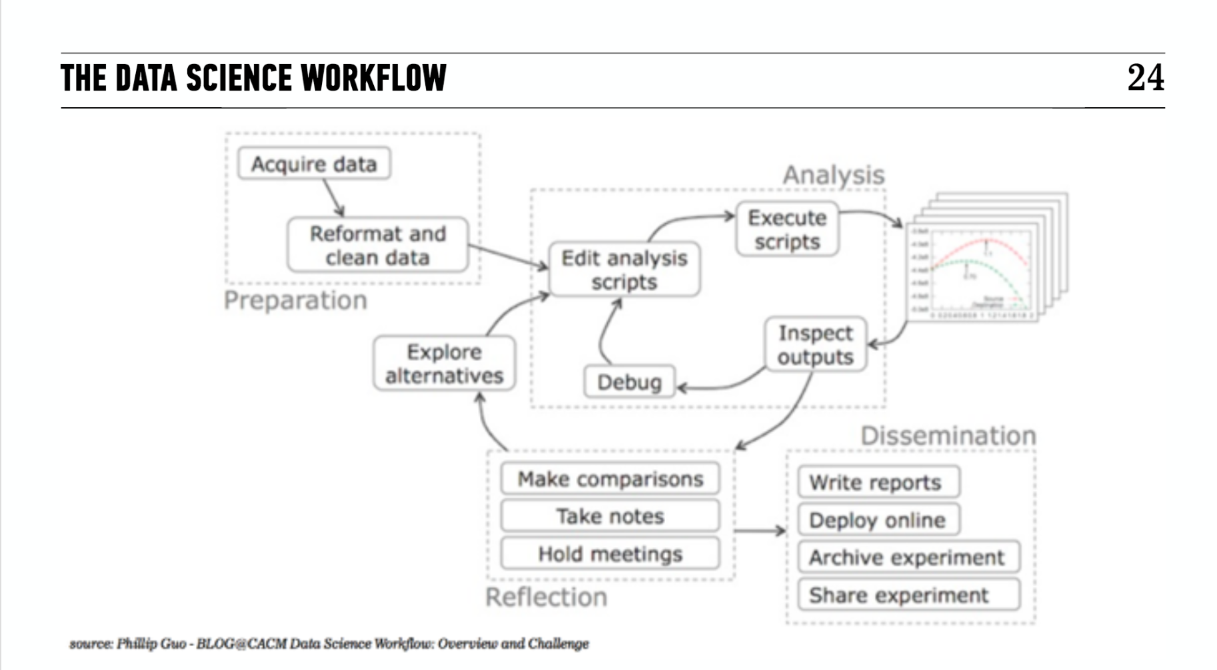

Slide 13
Where we are now

Slide 14
Anonymous Quiz
https://b.socrative.com/login/student/
MYALJT7C
Notes:
Feedback is a part of the GA experience. It is used to tweak the DAT experience from instance to instance. Helps instructors know what’s working well and what can be improved. Your producer, Daniel also communicates feedback to the appropriate teams that work behind the scenes at GA.

Slide 15
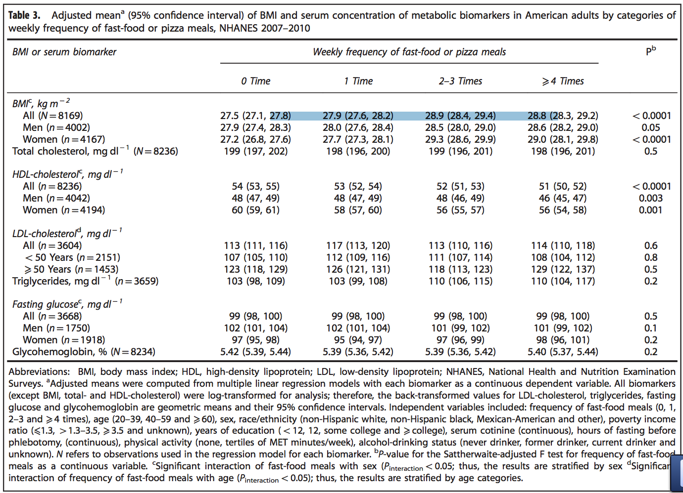
RESULTS
Notes:
Feedback is a part of the GA experience. It is used to tweak the DAT experience from instance to instance. Helps instructors know what’s working well and what can be improved. Your producer, Daniel also communicates feedback to the appropriate teams that work behind the scenes at GA.

Slide 16
Where we are headed…

Slide 17
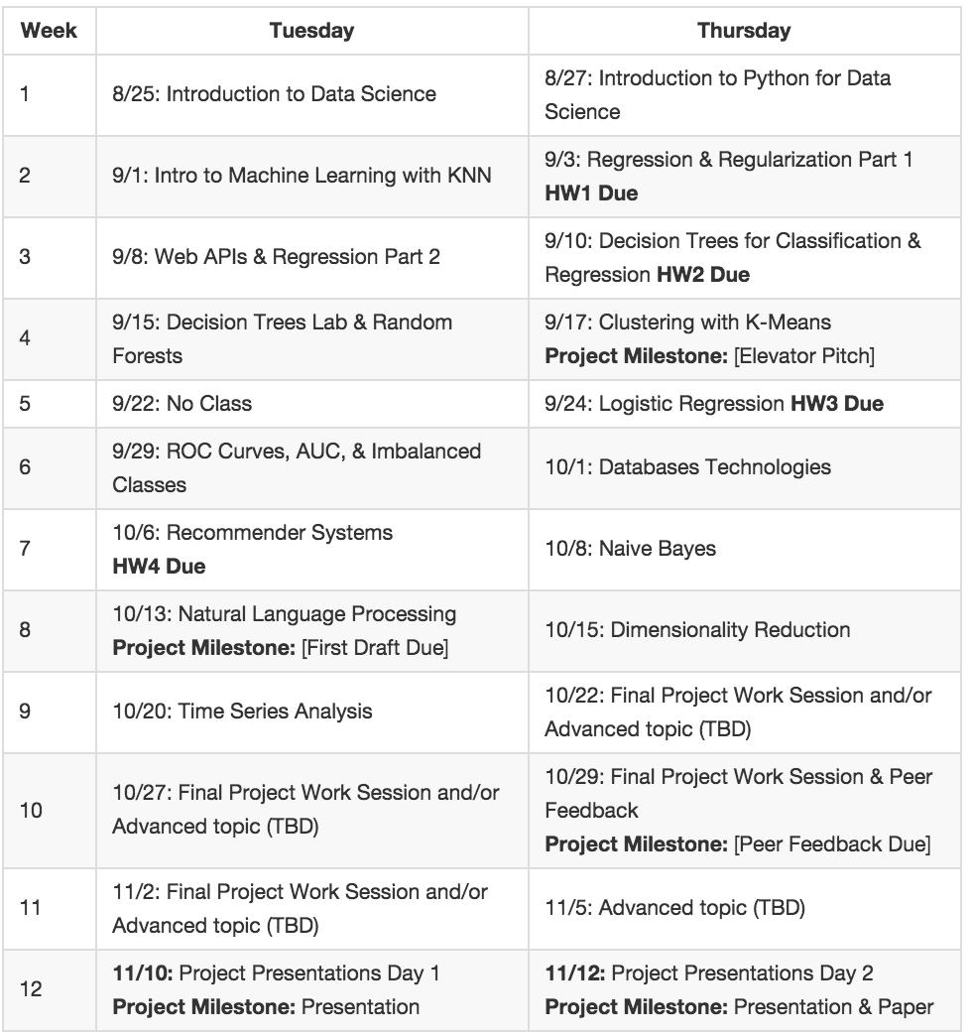
Notes:
Working with data, learning python tools, learning to define and categorize key Data Sci topics

Slide 18
Notes:
Survey of algorithms and more advanced tools

Slide 19
Notes:
Advanced topics and application→ this is the hard part but where things will really “click”

Slide 20
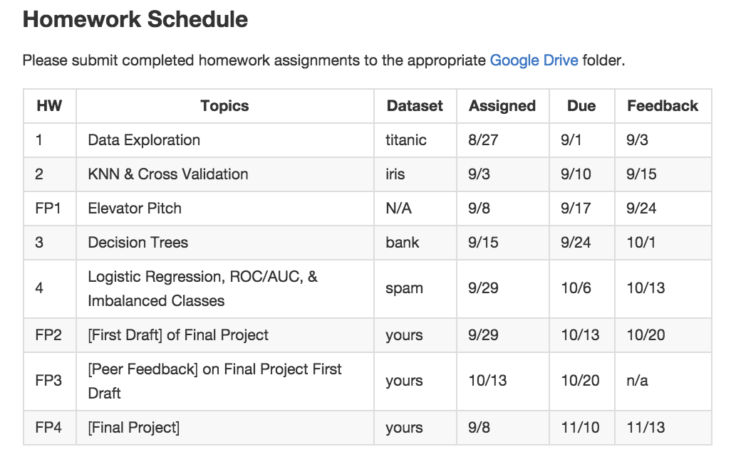

Slide 21
FINAL PROJECT
Design your own study
Acquire, clean and describe your data
Complete analysis
Assess validity of findings
Repeat previous steps as needed
Present findings through portfolio (github) and give a “job talk” on the analysis

Slide 22
END OF COURSE
Acquire, clean and parse large set of data using Python

Slide 23
END OF COURSE
Acquire, clean and parse large set of data using Python
Choose the appropriate modeling technique to apply to your data

Slide 24
END OF COURSE
Acquire, clean and parse large set of data using Python
Choose the appropriate modeling technique to apply to your data
Programmatically create predictive data models using machine learning techniques

Slide 25
END OF COURSE
Acquire, clean and parse large set of data using Python
Choose the appropriate modeling technique to apply to your data
Programmatically create predictive data models using machine learning techniques
Apply probability and statistics concepts to create and validate predictions about your data

Slide 26
END OF COURSE
Acquire, clean and parse large set of data using Python
Choose the appropriate modeling technique to apply to your data
Programmatically create predictive data models using machine learning techniques
Apply probability and statistics concepts to create and validate predictions about your data
Communicate your results to an appropriate audience

Slide 27
SMART GOALS AND DEV ENVIRONMENT LAB

Slide 28
SMART GOALS
Specific
Measurable
Attainable
Reasonable
Time Bound
Notes:
Feedback is a part of the GA experience. It is used to tweak the DAT experience from instance to instance. Helps instructors know what’s working well and what can be improved. Your producer, Daniel also communicates feedback to the appropriate teams that work behind the scenes at GA.

Slide 29
SMART GOALS
Obtain mastery of data science
Notes:
Feedback is a part of the GA experience. It is used to tweak the DAT experience from instance to instance. Helps instructors know what’s working well and what can be improved. Your producer, Daniel also communicates feedback to the appropriate teams that work behind the scenes at GA.

Slide 30
SMART GOALS
During the next 11 week course, I will learn to asses the advantages and disadvantage of different analytic methods and determine appropriate method for a given research question.
Specific
Measurable
Attainable
Reasonable
Time Bound
Notes:
Feedback is a part of the GA experience. It is used to tweak the DAT experience from instance to instance. Helps instructors know what’s working well and what can be improved. Your producer, Daniel also communicates feedback to the appropriate teams that work behind the scenes at GA.

Slide 31
SMART GOALS
During the next 11 week course, I will learn to asses the advantages and disadvantage of different analytic methods and determine appropriate method for a given research question.
Specific
Measurable
Attainable
Reasonable
Time Bound
Notes:
Feedback is a part of the GA experience. It is used to tweak the DAT experience from instance to instance. Helps instructors know what’s working well and what can be improved. Your producer, Daniel also communicates feedback to the appropriate teams that work behind the scenes at GA.

Slide 32
SMART GOALS
Obtain mastery of data science
Specific
Measurable
Attainable
Reasonable
Time Bound
Notes:
Feedback is a part of the GA experience. It is used to tweak the DAT experience from instance to instance. Helps instructors know what’s working well and what can be improved. Your producer, Daniel also communicates feedback to the appropriate teams that work behind the scenes at GA.

Slide 33
SMART GOALS
Obtain mastery of data science
Specific
Measurable
Attainable
Reasonable
Time Bound
Notes:
Feedback is a part of the GA experience. It is used to tweak the DAT experience from instance to instance. Helps instructors know what’s working well and what can be improved. Your producer, Daniel also communicates feedback to the appropriate teams that work behind the scenes at GA.

Slide 34

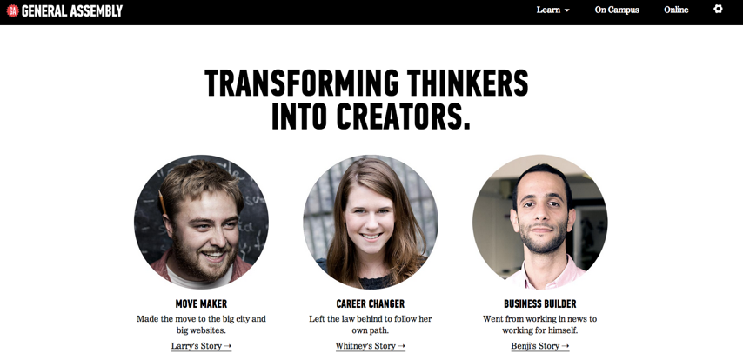
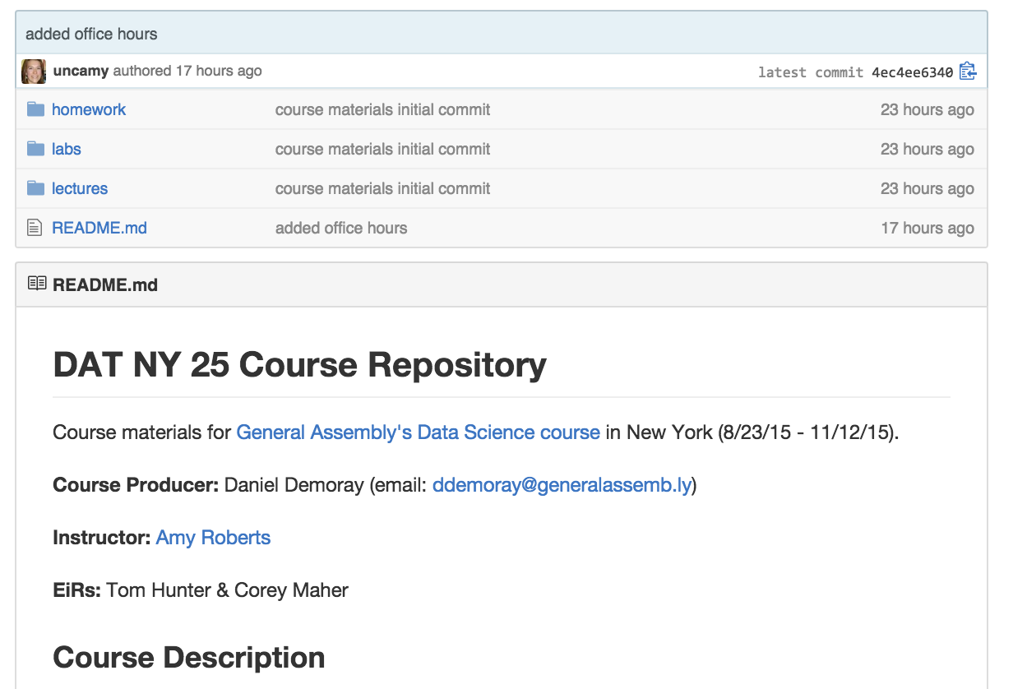
Course Site
https://github.com/ga-students/DAT-NYC-25
Notes:
Feedback is a part of the GA experience. It is used to tweak the DAT experience from instance to instance. Helps instructors know what’s working well and what can be improved. Your producer, Daniel also communicates feedback to the appropriate teams that work behind the scenes at GA.

Slide 35
LAB
Dev Environment
Example: During the next 11 week course, I will learn to asses the advantages and disadvantage of different analytic methods and determine appropriate method for a given research question.
Specific
Measurable
Attainable
Reasonable
Time Bound
DELIVERABLE:
Successfully open ipython notebook, read in data, and print a dataframe
DELIVERABLE:
Post SMART goals to drive folder
Notes:
Feedback is a part of the GA experience. It is used to tweak the DAT experience from instance to instance. Helps instructors know what’s working well and what can be improved. Your producer, Daniel also communicates feedback to the appropriate teams that work behind the scenes at GA.

Slide 36
Exit Ticket

Slide 37
TODAY
Described the roles of GA staff and students to create a successful learning environment for data science
Define data science and took a first stab at interpreting results from existing analysis
Set individual learning goals for the course
Dev Environment sorted
Notes:
Feedback is a part of the GA experience. It is used to tweak the DAT experience from instance to instance. Helps instructors know what’s working well and what can be improved. Your producer, Daniel also communicates feedback to the appropriate teams that work behind the scenes at GA.

Slide 38
UP NEXT
Dive into python for data analysis
Explore descriptive stats and their importance
Notes:
Feedback is a part of the GA experience. It is used to tweak the DAT experience from instance to instance. Helps instructors know what’s working well and what can be improved. Your producer, Daniel also communicates feedback to the appropriate teams that work behind the scenes at GA.

